Slide 1
Agile Methodologies and Culture
A Module in Agile Fundamentals
Notes:
Hello, and welcome to The Origins of Agile Software Development, a module in Agile Fundamentals. This module is brought to you by ThoughtWorks Studios, makers of Mingle, Cruise, and Twist.
Pay attention, this session is pretty frontal, to keep it on time don’t anticipate topics that will be discussed in following sessions, such as
Agile ceremonies (in Visibility and Communication)
Work flow and process (in Project Flow and Team)
Teamwork principles (in Project Flow and Team)
Estimations and Planning (in Estimation and Release and Iteration Planning)

Slide 2
What Flavor of Agile?
Scrum
Crystal Clear
Extreme Programming (XP)
Adaptive Software Development
Feature Driven Development
Dynamic Systems Development Method (DSDM)
Lean Software Development
Notes:
Historical overview of different Lean and Agile frameworks, the Origins of Agile Software Development

Slide 3
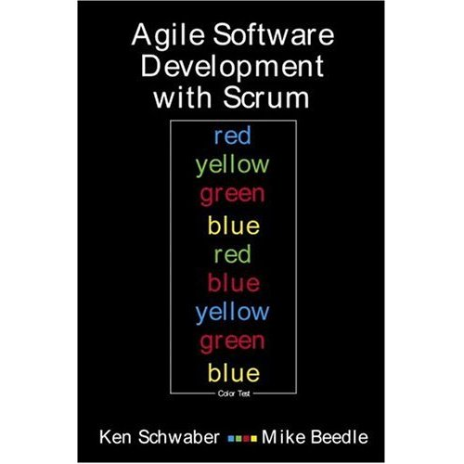
Scrum
Primarily a project management method
Project planning
Release planning
User Stories
Daily stand-up
Story points
Velocity
Notes:
Ideas from ‘85, officially presented in ’95, by Ken Schwaber
Focus on management practices
3 pillars: transparency, inspect, adapt
Defines roles, responsibilities and ceremonies
Empirical vs prescriptive predefined process
Formalize recurring team’s retrospective meeting
Explicitly mention self-organizing teams

Slide 4

Extreme Programming (XP)
Primarily a developer-centric approach
Test Driven Development (TDD)
Unit tests
Pairing
Continuous Integration (CI)
Refactoring
Notes:
Kent Beck mainly, also with Ron Jeffries and Ward Cunningham, developed in ’95
‘95 Chrysler payroll system, first large scale OO projects with SmallTalk
Focus on coding and engineering practices
Principle: when something hurts or is difficult, do it more often in small steps, this will develop skills and practices (e.g. design/refactoring, testing, releasing, code reviews, …)

Slide 5
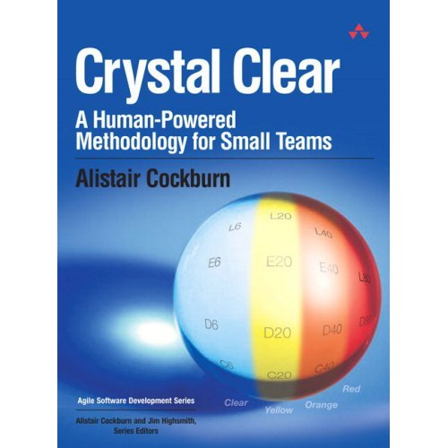
Crystal Clear
Focuses on people, not methods or artifacts
Teams of 6 to 8
Co-location
Reflective improvement
Team safety
Singular focus
Notes:
Alistair Cockburn, from a study for IBM about how most successful teams worked, from the ’90
Main focus on people
Part of a family of processes categorized by
Team size
System criticality (no significant $ loss, significant $ loss, life critical)
Projects priorities (time to market, productivity, legal liabilities)
Main focus on people

Slide 6

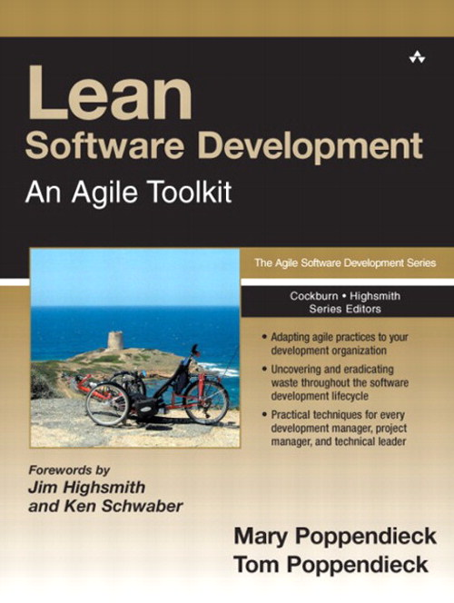
Lean Software Development
Optimize the whole
Eliminate waste
Build quality in
Learn constantly
Deliver fast
Engage everybody
Keep getting better
Notes:
Ideas from ‘50 from the Toyota Production System, manufacturing (Taiichi Ohno, Deming)
‘90 adapted to software development, Tom & Mary Poppendiek (“pop – en – dike”) , Alan Shalloway
Many Lean sw schools:
The Kanban method, David J. Anderson
Lean Startup, Eric Ries
Lean and agile are deeply intertwined in the software world. You can't really talk about them being alternatives, if you are doing agile you are doing lean and vice-versa
http://martinfowler.com/bliki/AgileVersusLean.html
Few key points
Focus on the entire process, from concept to cash, from the idea to the running product in the hands of the final user
Just-In-Time production driven by demand (maximize work finished, pull system)

Slide 7
Success Influencers
Notes:
We combine the best elements of all agile approaches, so when we talk about “agile” it can mean a range of things.
TW approach: a mash up with different practices, looks for each context at each practice benefit and effort to adopt, and decide

Slide 8
Notes:
Only historical reference here:
17 people met in Utah
to share info about their successful approach to sw dev that was very different from current trend (heavyweight prescriptive processes)
To identify commonalities
To choose a common name
Where do you come from, ad-hoc or waterfall-ish approach ?
More about the manifesto later.

Slide 10
So What?
Goal
Fundamentals
Ceremonies
Techniques
Iterations
User stories
Training
Co-location
Deliver high-value, high-quality working software quickly and frequently
Short feedback loops
Task cards
Project kick-off
Story board
Burn chart
Release planning
Grooming the backlog
Inspect and adapt
Iteration planning
TDD
Collaboration and teamwork
Planning poker
Daily stand-up
Done-done-done
Review / demo
Pairing
Unit tests
Retrospective
Participate
Continuous integration
Notes:
Agile culture and mindset
-----------------------------------------
General intro on the goal
We combine the best elements of all agile approaches, so when we talk about “agile” it can mean a range of things.
But the focus is always the same – delivering business value effectively and quickly
Don’t be fooled into thinking that if you do all the things on the right that you are agile – if you are not delivering business value, you have lost the plot.
To achieve this, culture and mindset are fundamental !

Slide 11
Notes:
What do these ideas mean to us?
Something over something else
Not instead of
Both sides have value
Items on the right have value BUT
We value the left items more
-------------------------------------------------------------------------------
Let’s talk for a few minutes about the four key ideas these folks wrote into the Agile Manifesto, and what they mean to us.
First, we’ll consider the wording. Note that every one of these is phrased as something over something else. That’s not instead of or is better than. No, it’s over. That means that both sides of the statement have value, and that the folks who authored the Manifesto were expressing a preference for one over the other.
In fact, what you don’t see on this illustration is the sentence that comes after the four points in the manifesto: “That is, while there is value in the items on the right, we value the items on the left more. “
Now let’s look at them one by one…

Slide 12
The Agile Manifesto
exercise
Preparation
Agile Manifesto in your workbook
Break into 4 groups
Discuss why you think the manifesto is arranged this way, and why the items on the left or more important to us than those on the right.
You may be asked to share your answers with the rest of the workshop
Notes:
Have them get into four groups, giving one statement to each group.
Have them discuss why the manifesto is organized this way, and what each statement means – 5 mins
Ask each group to share their thoughts on their statement. Ask the other participants their opinion or if they want to add / clarify anything after each pair presents.

Slide 13
Notes:
Processes and tools should support people’s work and their collaboration
People shouldn’t have to work around problems created by tools and processes.
When this happens, we give priority to people and interactions (we keep the process simple and let them tweak it, we let them choose tools keeping in mind that they have to be simple, flexible and replaceable).
---------------------------------------------------------------------------------------
Individuals and Interactions over Processes and Tools
TW supports tools – creator of tools
People talking is more important to insuring the success of a project
Process and tools should encourage and facilitate conversation
Robert Frost said
“I am a writer of books in retrospect. I talk in order to understand; I teach in order to learn.”
Ernest Hemingway said
“When people talk, listen completely. Most people never listen.”
---------------------------------------------------------------------------------------
As a toolmaker, clearly ThoughtWorks Studios believes that there is value in tools and the processes that they support. In fact, all of us use tools every day in our jobs and our lives. Whether it’s a computer, keyboard, mouse, and monitor, or a toaster or a coffee maker, tools make our lives easier. What the authors of the Agile Manifesto were focusing on, however, was their belief that it is people, and the interactions between people, that are more important in ensuring the success of projects. People talking to people, and people as skilled craftspeople and experts in their fields – these are the things to focus on.
Robert Frost said “I am a writer of books in retrospect. I talk in order to understand; I teach in order to learn.” That goes right to the heart of Individuals and Interactions. Agile teams are always teaching each other and learning from each other. Tools and processes are there to free them to do these and other things, not to be the focus of their efforts.
And Ernest Hemingway said “When people talk, listen completely. Most people never listen.” The interactions between individuals require both talking and listening, along with a leavening of doing.

Slide 14
Notes:
We are talking primarily about specs, design and code docs for the team that write the sw.
First we want to understand this, then we can talk also about User manuals or API manuals.
Knowledge transfer required to release well functioning sw that fit users’ needs is the goal here.
Up to date docs that people actually read and find valuable are good.
Out of date docs, docs people don’t read or don’t find valuable are a waste.
Docs created as quick fix or shortcut for not doing the right thing first are a waste.
-----------------------------------------------------
Everyone has experienced excess documentation
US government has documents to describe documents required for projects
Requirements specs
Design specs
Functional specs
Test specs
Code documentation
Test results, etc
Much time to prepare
Maybe read once
Out of date quickly
Show vs tell
Idea came out of Rapid prototyping and collaboration
-------------------------------------------------------------------------------------------------
Working Software over Comprehensive Documentation
If you’ve been in the software profession for any length of time, you’ve either been responsible for, involved in, or the victim or beneficiary of some form of documentation or other. The US Government has documents that describe and define the documents that are required for a project. In almost every type of business, it is common to have Requirements Specifications, Design Specifications, Functional Specification, Test Specifications, Code Documentation, Test Results Reports, and so on.
The problem with this is that highly skilled people spend a significant chunk of their time writing documentation that might be read only once, if at all. Sure, the design specs and test specs will be referred to over and over during development and testing. And that’s about it.
The authors of the Agile Manifesto were focused more on show and tell than they were on writing about it. They came out of the world of rapid prototyping and engaging with the customer and the user in new ways, and thought that it made more sense to spend development time on – you guessed it – development.
Of course, there’s still a place for documentation. However, in Agile teams, we try to find ways to either have the system be self-documenting, or to simplify the documentation requirements. As you go through later modules in this course, we’ll talk about things like “test first” and TDD, user stories, showcases, and more.

Slide 15
Notes:
Contracts are useful to clarify what is offered and what is expected., the rights and the obligations.
Contracts are useful when one of the party is in trouble.
Should not be
an obstacle to collaboration,
a source of rigidity,
an excuse for not having ongoing conversations to adapt in maximizing the value, incorporating what is learned, adapting to new circumstances.
---------------------------------------------------------
Contracts are to enforce agreements
Contracts are referenced when a party has not lived up to their commitment.
Specifications represent contracts.
Isadora Duncan said,
“Any intelligent woman who reads the marriage contract, and then goes into it, deserves all the consequences.”
Specs created too early are likely to change
Business changes
The economy changes
Changes require a lot of work
Negotiation
Meetings
Budgets
Lawyers
Perhaps Diane Sawyer said it best:
“I have a contract but it's not a commitment in the ordinary sense. It's our ongoing conversation.”
Spend more time talking to your customer than negotiating contracts
----------------------------------------------------------------------------------------------------------
Customer Collaboration over Contract Negotiation
Contracts are in place to enforce agreements. The only time that contracts are referenced is when one party or another has not lived up to their commitment. In software development, specifications represent contracts, if you consider that they spell out what the customer or product manager or user wants, and what the development team commits to delivering.
Isadora Duncan said, “Any intelligent woman who reads the marriage contract, and then goes into it, deserves all the consequences.” Most of us, on reading contracts, are inclined to say “that’s unenforceable” or “they’ll never make us stick to that.”
The problem is that things change. Business circumstances change. The economy changes. Our understanding of the work we do, what our customers need, or the environment in which it’s done changes. And then, if we have a contract, we have to renegotiate, with all that entails – meetings, lawyers, reviews, budgets, schedules, and so on.
Perhaps Diane Sawyer said it best: “I have a contract but it's not a commitment in the ordinary sense. It's our ongoing conversation.”
The authors of the Agile Manifesto seem to believe that it makes more sense to spend more time talking to your customer than spending time negotiating a contract. The time spent with the customer, however, should be focused on the software and the goals to be achieved and the value created or delivered by that software. That is, the time should be spent talking about the things that actually matter.

Slide 16
Notes:
More later about this, that’s a key element of agile culture
------------------------------------------
Types of change we experience
Economy, Business, Consumer needs, Technology
“Do you want us to meet our delivery date, or do you want this feature added in?”
“Sure, we can do that. As soon as we renegotiate the contract, modify the project plan, get agreement from all parties, and set a new delivery date.”
Agile handles change well
Plans are good. Plans are necessary but change is inevitable.
Plan, then respond to change.
W. Edwards Deming, Plan-Do-Check-Act.
make a plan, execute against the plan, see how you’re doing, and adjust accordingly.
Colin Powell’s thought that
“No battle plan survives contact with the enemy.”
------------------------------------------------------------------------------------------------------
Responding to Change over Following a Plan
We’ve talked about change a bit already. In fact, responding to change is one of most difficult things we deal with in life, both at work and elsewhere. In most waterfall organizations, following a plan is far more important than responding to change. Many of us have found ourselves in situations where we’ve had to say “Do you want us to meet our delivery date, or do you want this feature added in?” or “Sure, we can do that. As soon as we renegotiate the contract, modify the project plan, get agreement from all parties, and set a new delivery date.”
Responding to change is one of the hallmarks of Agile. Being able to respond to changes in economy, business, consumer needs and desires, technology, or architecture is crucial to the success of software projects. And yet in Waterfall, it seems like we do everything we can to avoid change and stick to the plan.
Plans are good. Plans are necessary.
According to W. Clement Stone, “No matter how carefully you plan your goals they will never be more that pipe dreams unless you pursue them with gusto. “ This is akin to the Japanese proverb, “Vision without action is a daydream. Action without vision is a nightmare.”
According to Napoleon Hill, “Create a definite plan for carrying out your desire and begin at once, whether you ready or not, to put this plan into action.”
And then there’s Colin Powell’s thought that “No battle plan survives contact with the enemy.” Although this one is more properly attributed to Helmuth von Motlke the Elder, a disciple of Clausewitz.
All of these help us to understand the Agile approach to planning: get enough information to get started, build something, show the customer, and then respond to their feedback. Or in the terms of W. Edwards Deming, Plan-Do-Check-Act. That is, make a plan, execute against the plan, see how you’re doing, and adjust accordingly.
That is, plan and respond to change. Both.

Slide 18
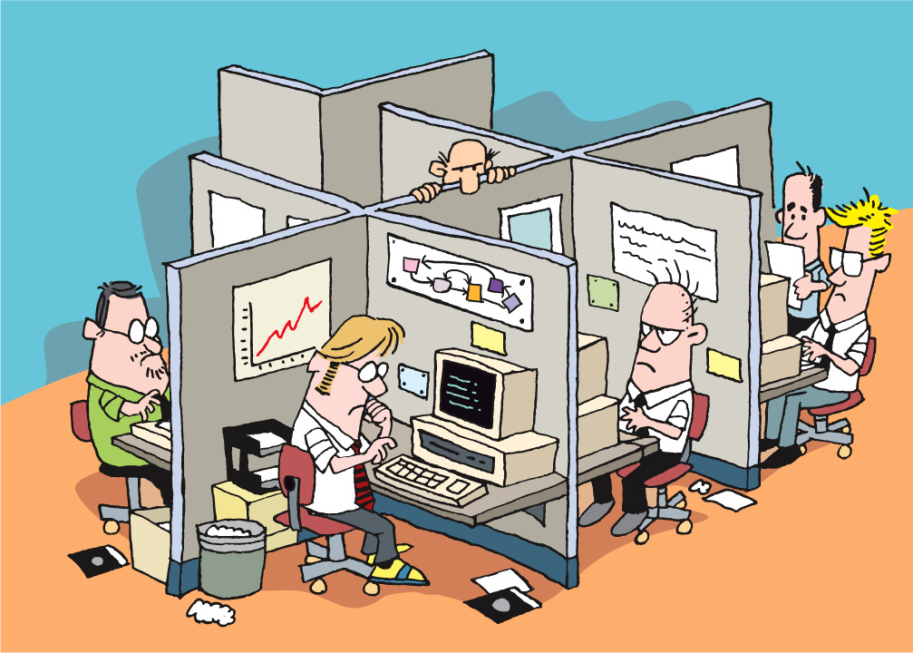

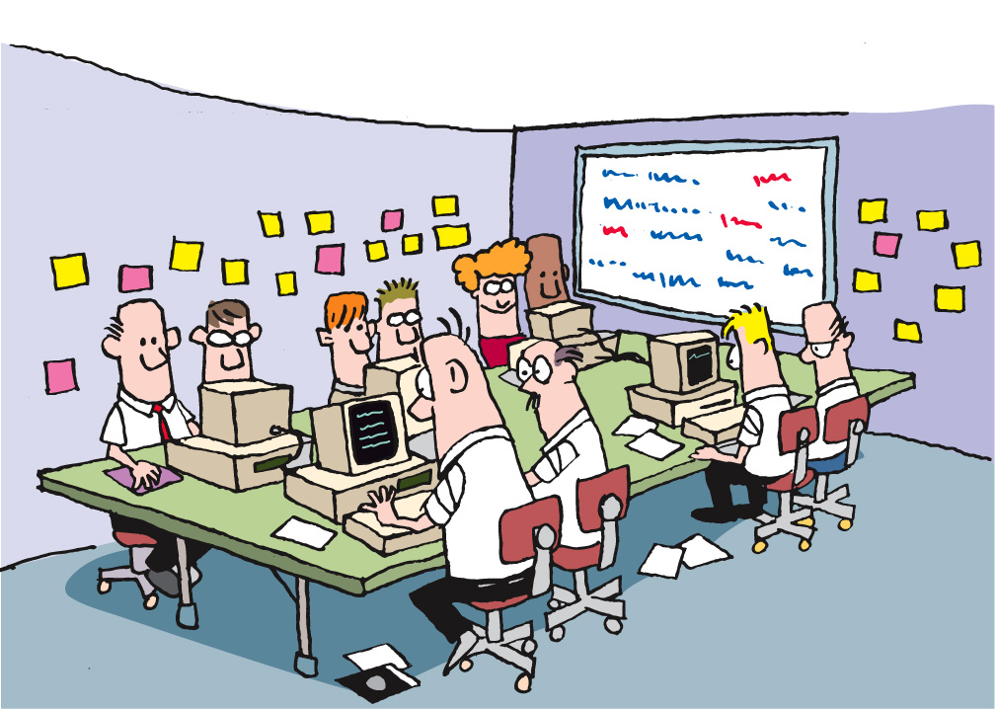
Agile Methodologies
Notes:
What type of environment do you work in?
Any of these look familiar?
The importance of people factor and great
highly performing
well functioning
self organizing
Cross functional
100% membership
team with good
attitude,
community,
collaboration,
Trust
discipline
morale

Slide 19
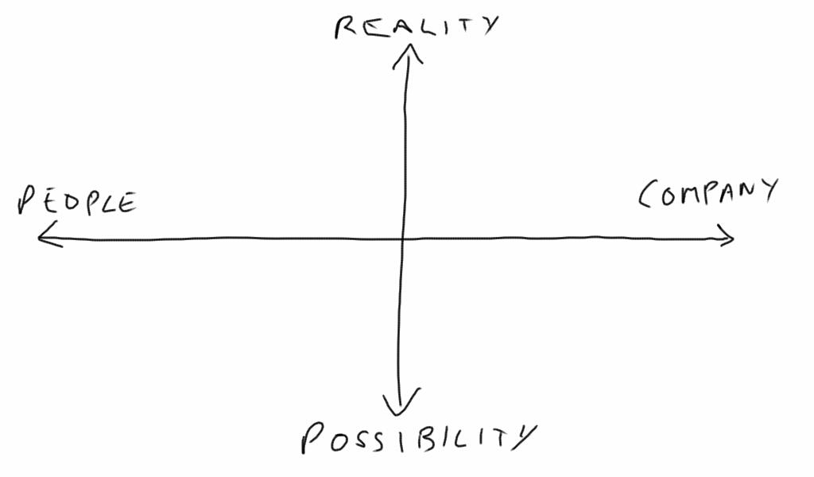
Culture
Or, how we get things done around here
We succeed by working together
We succeed by keeping control
Partnership
Trust
Process
Power
Synergy
Standardization
Collaboration
Control
Diversity
Security
Partnership
Predictability
Efficiency
Dedication
Creativity
Expertise
Cultivation
Growth
Competence
Be the best
Subjectivity
Purpose / faith
Craftsmanship
We succeed by growing people who fulfill our vision
We succeed by being the best
“The Reengineering Alternative” by William Schneider
Notes:
Some info about the quadrant here:
http://blogs.ugidotnet.org/luKa/archive/2013/01/21/is-your-organizations-culture-compatible-with-lean-and-agile.aspx
Need to get a feel for the culture of the organization, so we do a culture analysis.
Draw this diagram on a whiteboard or poster.
Put quadrant diagrams on the wall (3 or 4 of them).
Dot voting for culture – 3 mins
See where their cultural norms are – this will affect how the organization adopts agile.
Collaboration = agile
Cultivation = agile
Control = kan-ban
Competence = very difficult to adopt anything new – not invented here syndrome typically applies
Just information for the attendees, and they will have to pay attention to their culture.

Slide 20
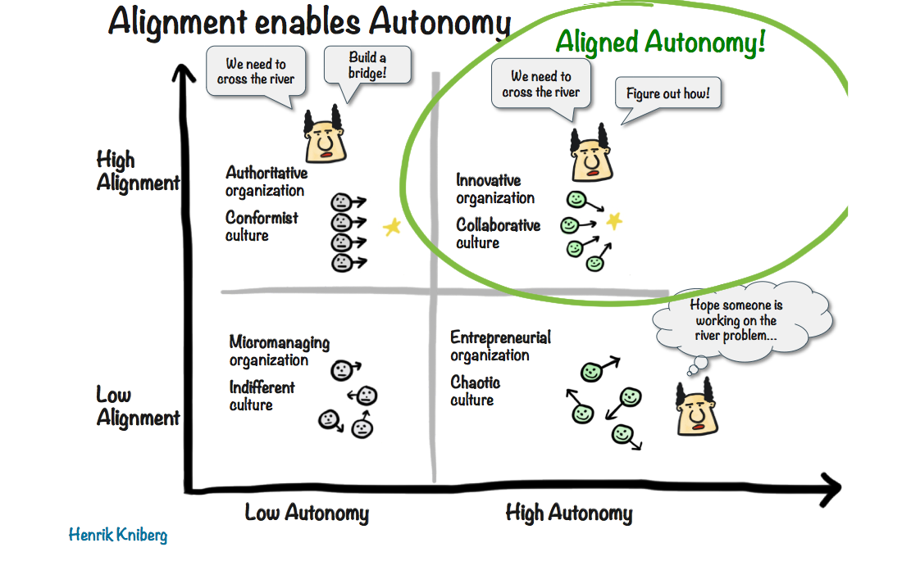

Slide 22
Anticipation ÷ Reaction
100%
Known
Notes:
Agile Culture and Mindset
----------------------------------------
Deal with unknown and uncertainty and change.
At the end of the project

Slide 23
Anticipation ÷ Reaction
? %
100%
Known
Unknown Uncertain
Change
Notes:
At the beginning of the project
Interdependently connected in a network, with increased Number and Speed of Interactions => decrease our ability to predict

Slide 24
Anticipation ÷ Reaction
Anticipation
Reaction
Curiosity
Confidence
Safety
Notes:
Human intelligence
Anticipation: making decisions based on predictions, expectations, or beliefs about the future
requires reflection, abstract thinking, preparation
Reaction: is based on the current state of the environment with no explicit regard to the future.
Too much reaction: because impulsiveness and lack of preparation.
Too much anticipation: because inconclusiveness and indecisiveness.
Human: lever is curiosity, confidence, perceived safety
Project: lever is balance between known and unknown/unchertain/change

Slide 25
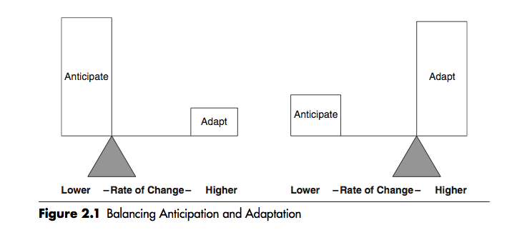
Anticipation ÷ Reaction
Notes:
Human intelligence
Anticipation: making decisions based on predictions, expectations, or beliefs about the future
requires reflection, abstract thinking, preparation
Reaction: is based on the current state of the environment with no explicit regard to the future.
Too much reaction: because impulsiveness and lack of preparation.
Too much anticipation: because inconclusiveness and indecisiveness.
Human: lever is curiosity, confidence, perceived safety
Project: lever is balance between known and unknown/unchertain/change

Slide 26
Where Agility is beneficial ?
The environment is highly connected with frequent interactions that cause a diminished capacity to predict
Notes:
Viral, domino effect
Social networks, stock market, blackout on electric supply network

Slide 27
Where Agility is beneficial ?
A certain level of shared understanding is needed to succeed in important endeavors because the high level of interdependency

Slide 28
Contexts where Agility lead to better performances
There exists rare, very low probability events that can occurs and bring great opportunities or risks, together with huge consequences

Slide 29
Where Agility is beneficial ?
There is a condition of time pressure because the amount of information and information processing required exceed the available time

Slide 30
Where Agility is beneficial ?
The nature and extent of the uncertainty associated with a situation affects our ability to both formulate the problem and find an acceptable solution.

Slide 31
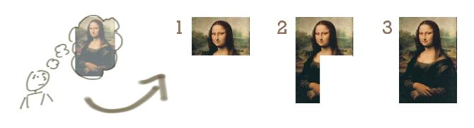
Notes:
Task work Vs Knowledge work
Task work (like printing a book, an article):
- we know everyting before we start working
We do everything pixel perfect from the beginning
We deliver in the end (when all the scope is implemented)

Slide 32
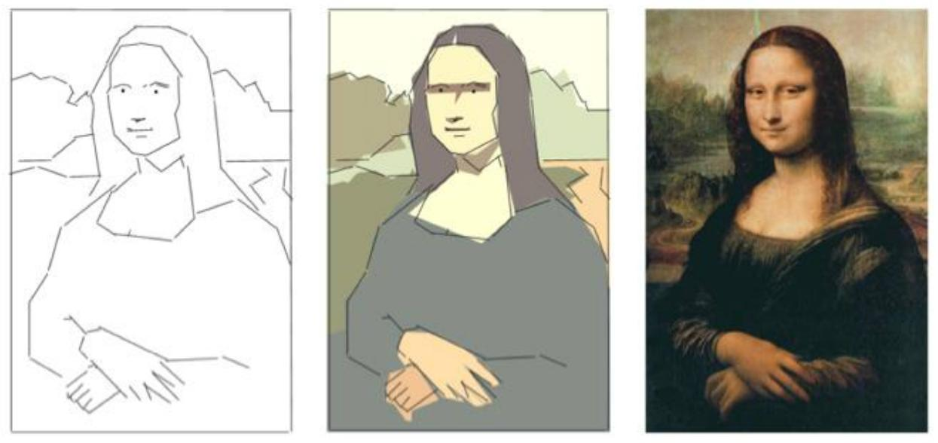
Notes:
Knowledge work (like writing a book, an article):
We learn, discover and improve while we do. “Failure” is part of the game
We can deliver value early (when value created is good enough, when I reach the best I can do, when the time is over)

Slide 33
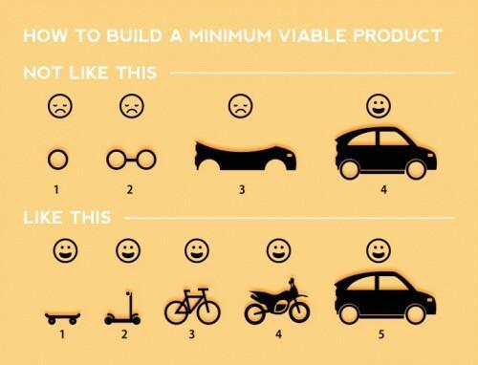

Slide 35

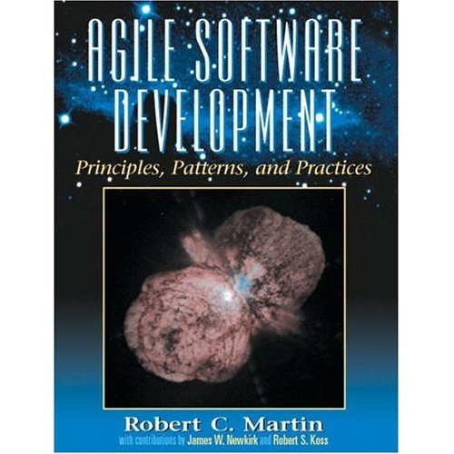



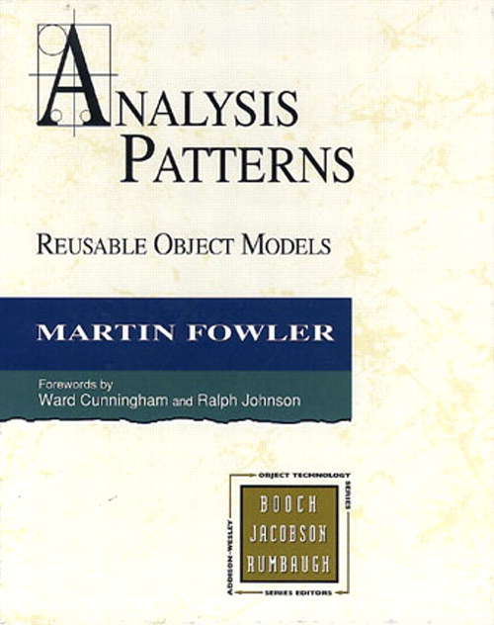
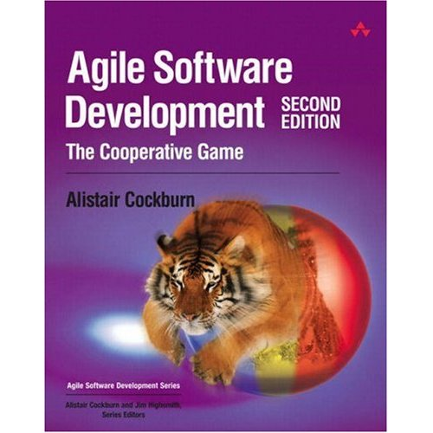

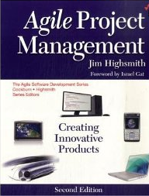
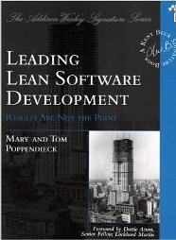
Notes:
There are lots of books on the subject of agile development, and you may want to reads some of them for yourself.

Slide 36
Questions?
Notes:
So, now we can move-on to actually putting agile practices – all founded on these beliefs and strategies – into action.
There is no more simple lecture – everything now is listen / discuss / do. Time for some fun…

